Slide 1
AI FOR DS HEART DISEASE PREDICTION
Under the guidance of
Dr Figlu Mohanty
ROLL NO | NAMES
2110030099 | Praneetha
2110030359 | Chihnita
2110030412 | Yesashwini
2110030432 | Amar Sai
2110030444 | Dhana Sree

Slide 2
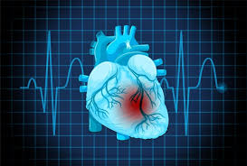
Contents:
Introduction
Problem Statement
Proposed system
Proposed model
References
Dataset Collection
Software Hardware Requirements
GitHub Setup

Slide 3
Introduction
Because of numerous contributing risk factors, including diabetes, high blood pressure, high cholesterol, abnormal pulse rate, and many other factors, it is challenging to diagnose heart disease.
Heart disease has received a lot of attention in medical research among other serious illnesses.
The diagnosis of heart illness is a difficult undertaking, but it can provide an automated prognosis of the patient's heart status to help with subsequent treatment.
The severity of the disease is classified based on several approaches such as K-Nearest Neighbor Algorithm (KNN), Decision Trees (DT), Genetic algorithm (GA), and Naive Bayes. >The diagnosis of cardiac disease is typically based on the signs, and symptoms of the patient (NB).

Slide 4
Problem Statement
Heart Disease Prediction using a Machine learning algorithm
The main objective for this is to develop a heart disease prediction system, the system can discover and extract hidden knowledge associated with diseases from heart data set

Slide 5
Applications:
Medical Institutions:-
To teach medical students
how the heart attack has been measured
how to identify that the person is suffering from heart disease.
Hospitals:-
To detect whether the person can be affected by any heart disease.

Slide 6

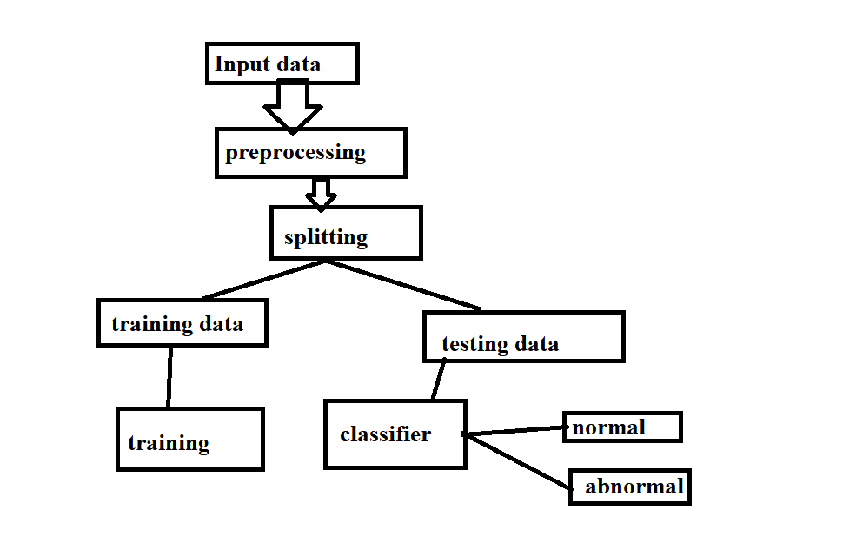
Proposed System

Slide 7
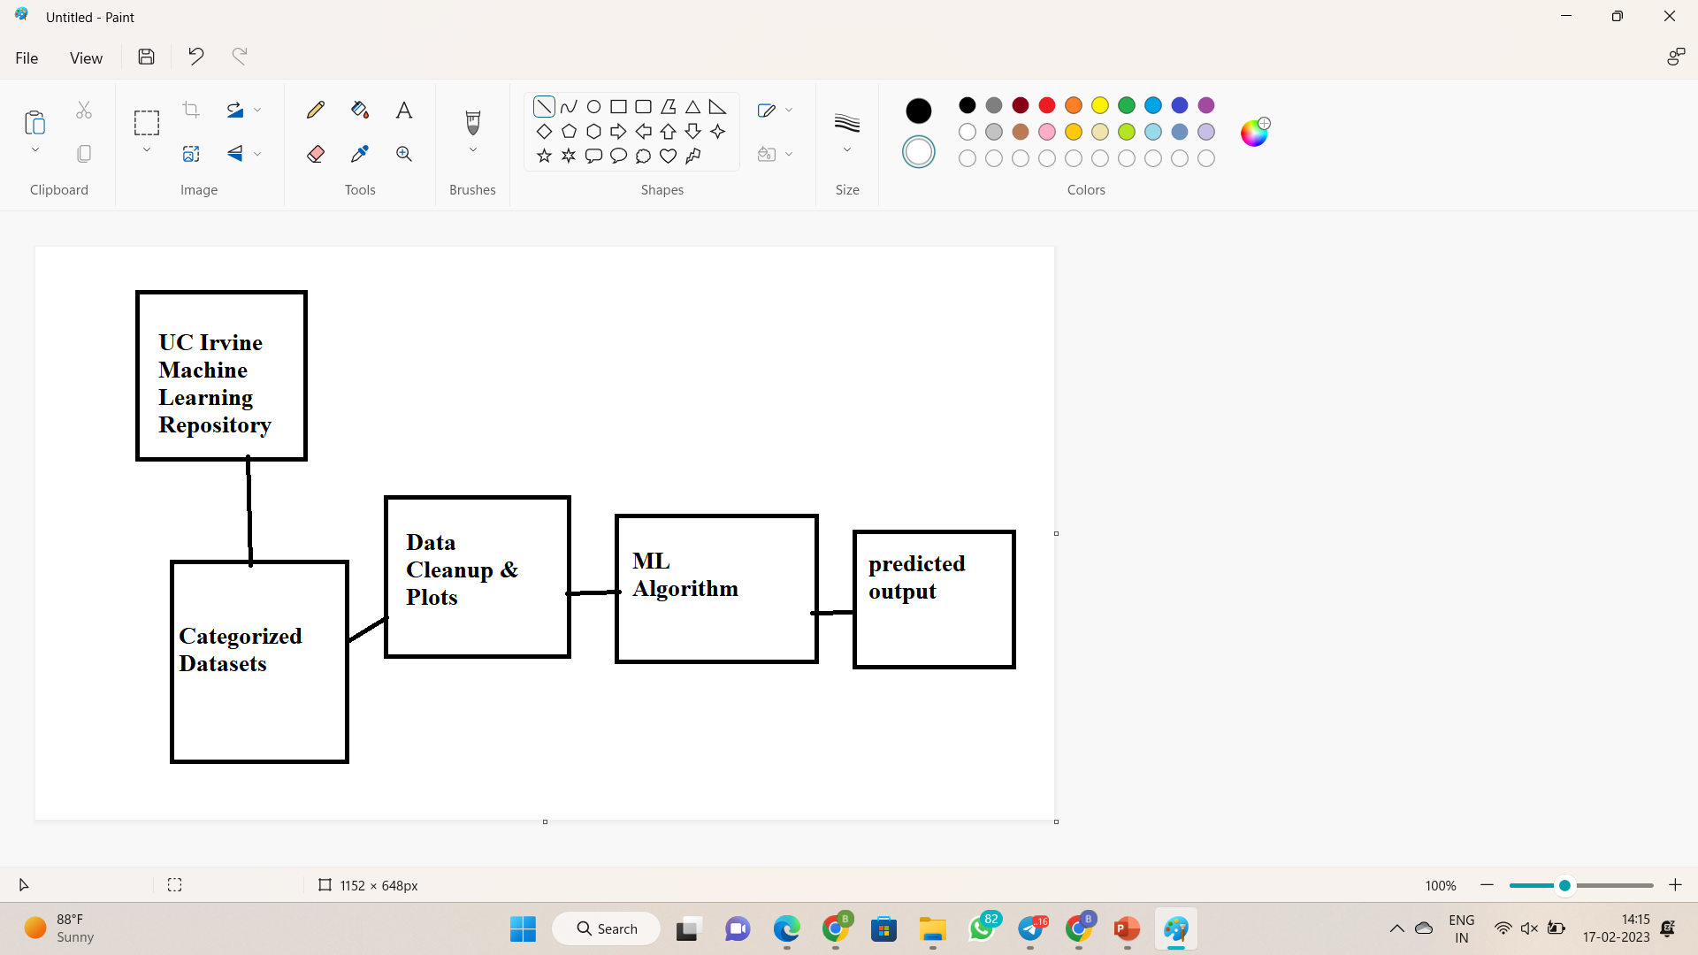
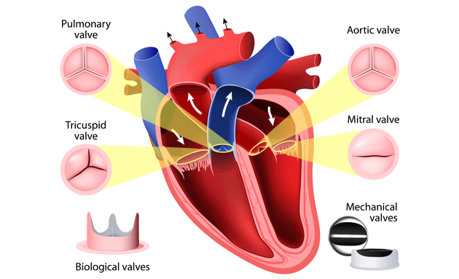
Proposed model

Slide 8
Approach Methodology
Machine learning Algorithms
Naïve bayes(NB)
Random Forest(RF)
Adaptive boositing(Adaboost)

Slide 9
Dataset Columns
age: The person’s age in years
sex: The person’s sex (1 = male, 0 = female)
cp: chest pain type — Value 0: asymptomatic — Value 1: atypical angina — Value 2: non-anginal pain — Value 3: typical angina
trestbps: The person’s resting blood pressure (mm Hg on admission to the hospital)
chol: The person’s cholesterol measurement in mg/dl
fbs: The person’s fasting blood sugar (> 120 mg/dl, 1 = true; 0 = false)
restecg: resting electrocardiographic results — Value 0: showing probable or definite left ventricular hypertrophy by Estes’ criteria — Value 1: normal — Value 2: having ST-T wave abnormality (T wave inversions and/or ST elevation or depression of > 0.05 mV)
thalach: The person’s maximum heart rate achieved
exang: Exercise induced angina (1 = yes; 0 = no)
oldpeak: ST depression induced by exercise relative to rest (‘ST’ relates to positions on the ECG plot. See more here)
slope: the slope of the peak exercise ST segment — 0: downsloping; 1: flat; 2: upsloping 0: downsloping; 1: flat; 2: upsloping
ca: The number of major vessels (0–3)
thal: A blood disorder called thalassemia Value 0: NULL (dropped from the dataset previously Value 1: fixed defect (no blood flow in some part of the heart) Value 2: normal blood flow Value 3: reversible defect (a blood flow is observed but it is not normal)
target: Heart disease (1 = no, 0= yes)

Slide 10
Dataset Collection
It is composed of 14 attributes which are age, sex, chest pain type, resting blood pressure, serum cholesterol, fasting blood sugar, resting electrocardiographic results, maximum heart rate achieved, exercise induced angina, old peak — ST depression induced by exercise relative to rest, the slope of the peak exercise ST segment, number of major vessels and Thalassemia. This database includes 76 attributes, but all published studies relate to the use of a subset of 14 of them.
One of the major tasks on this dataset is to predict based on the given attributes of a patient whether that particular person has a heart disease or not and other is the experimental task to diagnose and find out various insights from this dataset which could help in understanding the problem more.
Reference:-
https://www.kaggle.com/datasets/johnsmith88/heart-disease-dataset

Slide 11
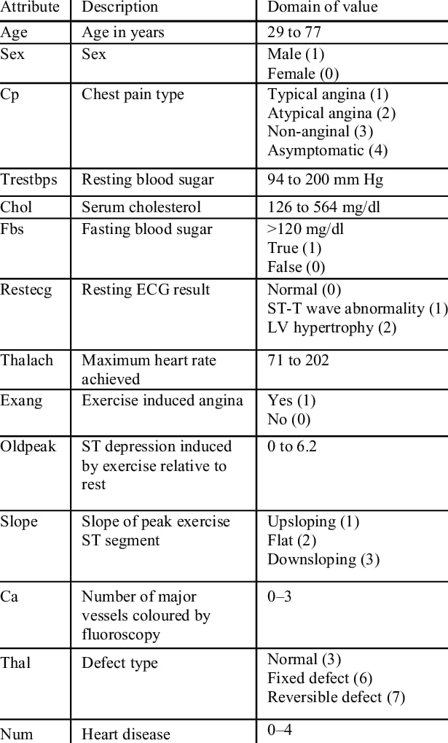
Dataset

Slide 12
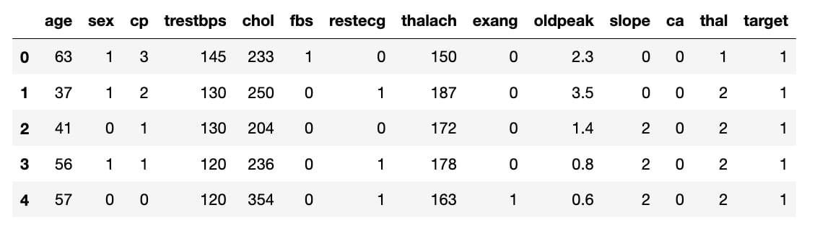
Dataset Collection

Slide 13
Hardware Components
Software Components
Intel ® Pentium ® RAM:
4 GB and above Hard Disk: 120
GB Speed: 1.6 GHz and above
Monitor: 15’’ LED SVGA Input
Devices: Keyboard, Mouse 5.2
Requirements Operating System: Windows 8/8.1/10
Coding Language: Python,
HTML & CSS Platform: Chrome v50 and above
Special Tools: Visual Studio Code, Jupiter Notebooks

Slide 14
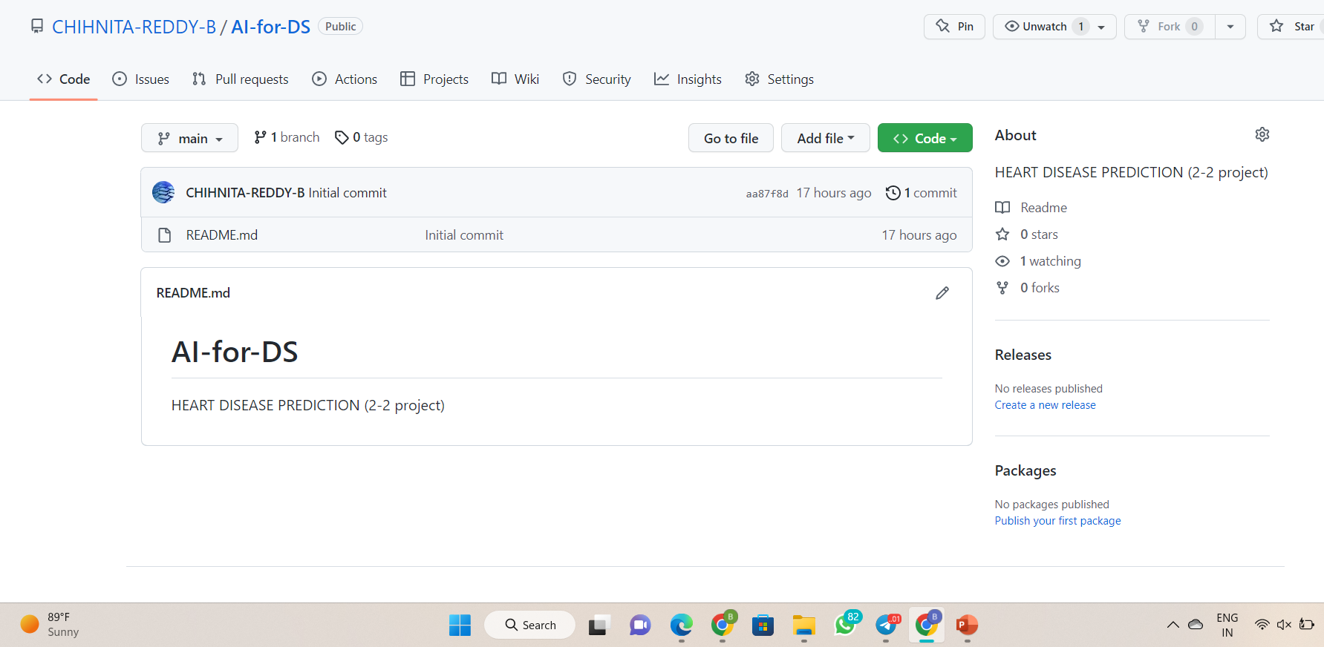
GitHub Setup
https://github.com/CHIHNITA-REDDY-B/AI-for-DS

Slide 15
References
Effective heart disease prediction using hybrid machine learning techniques:-Senthil Kumar mohan,chandrasegar thirumalai, and Gautam Srivastava -(19 JUNE 2019).
Prediction of Heart Disease Using Machine Learning:- Aditi Gavhane, Gouthami Kokkula, Isha Pandya, Prof. Kailas Devadkar (PhD) - 2018.
Prediction of Heart Disease at early stage using Data Mining and Big Data Analytics: A Survey:- Salma Banu N.K, Suma Swamy.-2019.
Prediction of Heart Disease Using Machine Learning Algorithms. :- Mr.Santhana Krishnan.J, Dr.Geetha.S.- 2019.

Slide 16
SUMMARY
Heart disease prediction is challenging and very important in the medical field. However, the mortality rate can be drastically controlled if the disease is detected at an early stage and preventive measures are adopted as soon as possible.
With the rising number of deaths due to heart disease, it is becoming increasingly important to build a system that can effectively and accurately forecast heart disease. The motivation for the study was to find the most efficient ML algorithm for the detection of heart diseases.

Slide 17
THANK YOU

